Slide 1


Madar
Tolerance Workshops
2025

Slide 2
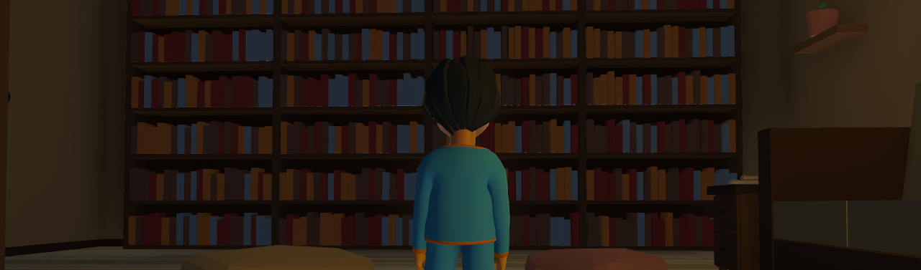
02
Unity Introduction
Create Games with a Purpose
Hamdan Al-Ali
www.tolerance.gov.ae

Slide 3
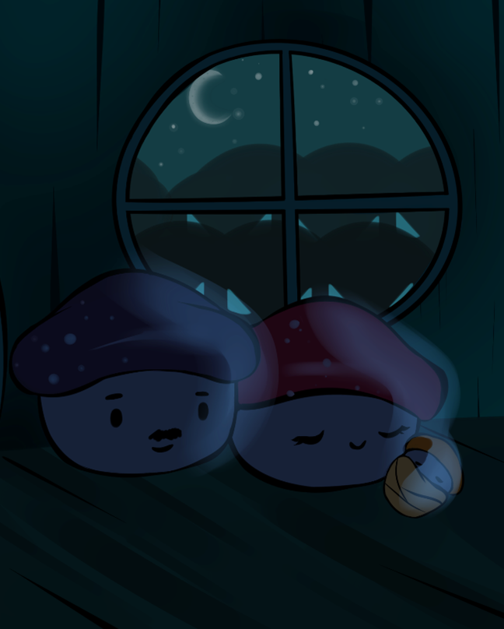
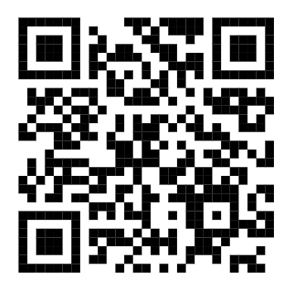
03
If you haven’t already, proceed to installing Unity:
www.tolerance.gov.ae
https://shorturl.at/ISFvE

Slide 4
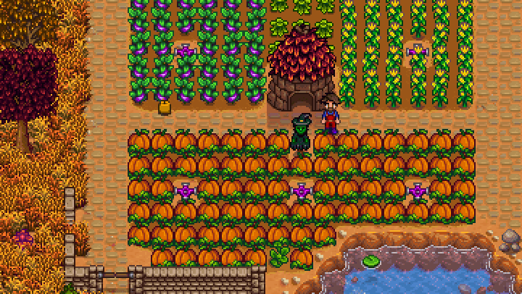
04
The Multimodal Nature of Games
Code: Creates logic and interactivity.
Art: Defines visual identity.
Music/Sound: Sets mood and atmosphere.
Narrative: Engages the player emotionally (optional but impactful).
And much more…
www.tolerance.gov.ae

Slide 5
Rubrics for Game Development
05
 | Excellent | Good | Satisfactory
Tolerance Integration (30%) | Game shows a powerful, original tolerance message. | Game integrates a clear tolerance message. | Message is present but unclear or inconsistent.
Message Clarity (25%) | Inspiring and obvious message throughout the game. | Clear message in most game parts. | Message is vague or hard to understand.
Gameplay (20%) | Engaging, smooth, and innovative mechanics. | Functional with minor issues. | Buggy or difficult to function properly.
Visual (10%) | Stunning, cohesive, and thematic. | Appealing with minor inconsistencies. | Graphics are out of place or poorly aligned.
Fun Factor (10%) | Highly enjoyable and replayable. | Enjoyable with moderate replay value. | Somewhat fun but lacks engagement.
Audio (5%) | Immersive and polished. | Appropriate with minor flaws. | Basic or inconsistent.
www.tolerance.gov.ae

Slide 6
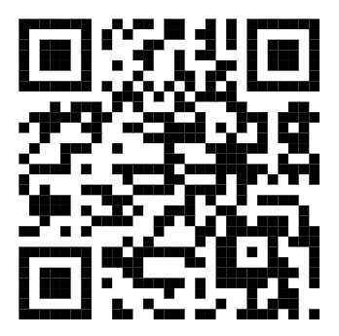
Let’s Create Our Teams
06
https://shorturl.at/kSOEp
www.tolerance.gov.ae

Slide 7
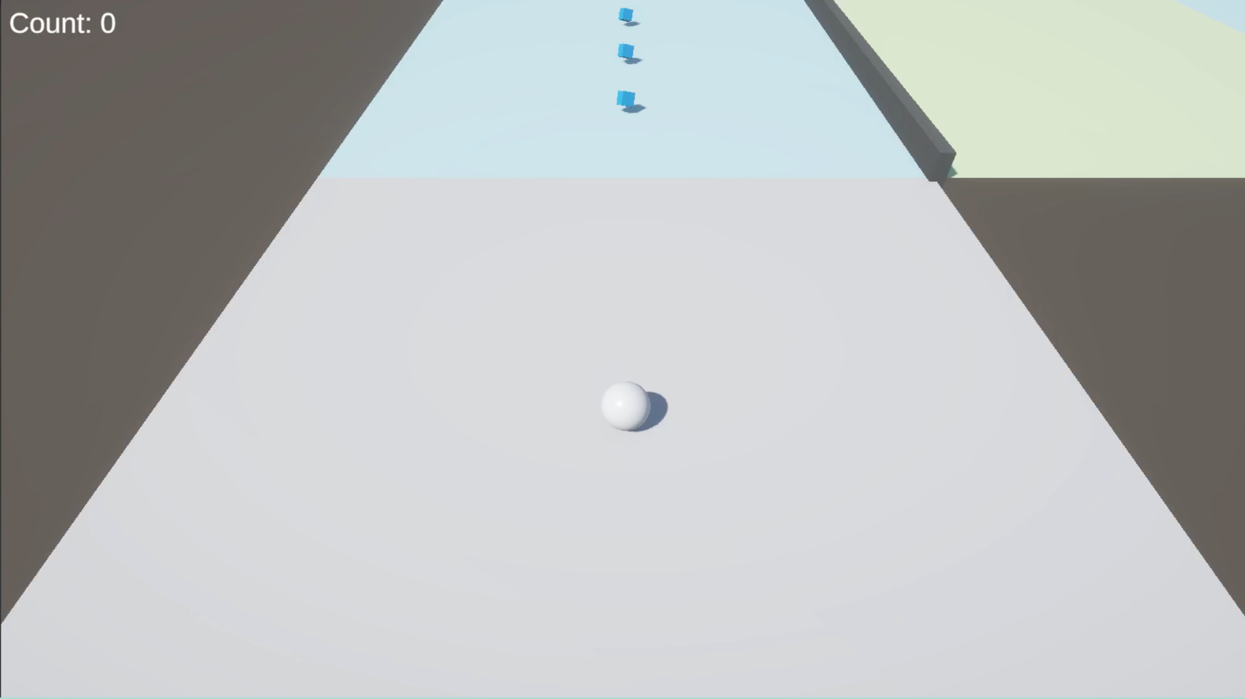
07
Our Project: Puzzle-platformer with a tolerance message.
www.tolerance.gov.ae

Slide 8
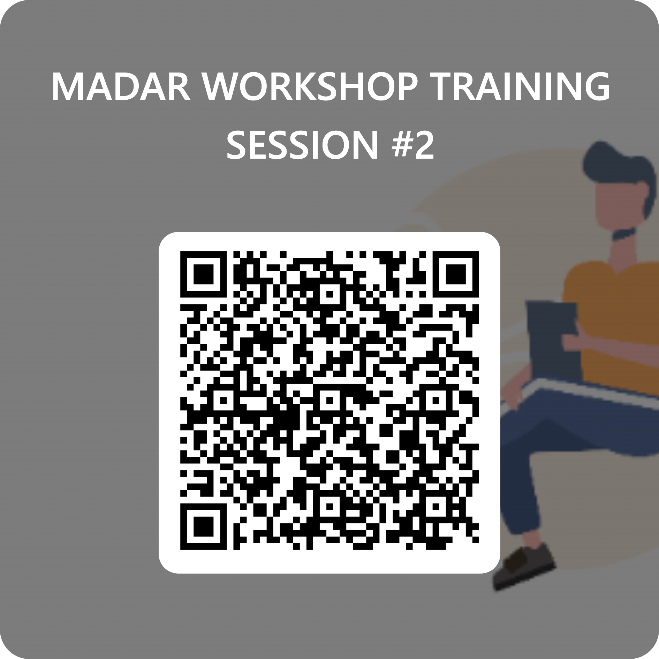
Attendance
07
www.tolerance.gov.ae
https://forms.office.com/r/MEQWBZfMgz

Slide 9
08
What will we learn today?
Creating Unity Project.
Unity User Interface.
Creating 3D Objects (Player, Tile and Collectables).
Parenting.
Using Materials.
Creating Prefabs.
Create Our First Map.
www.tolerance.gov.ae

Slide 10

If everything is clear, we move to Unity!

Slide 11
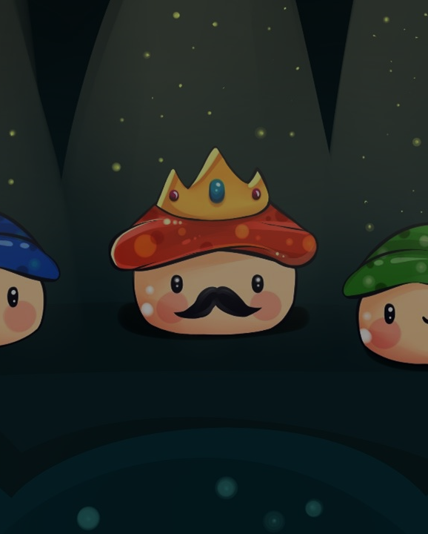
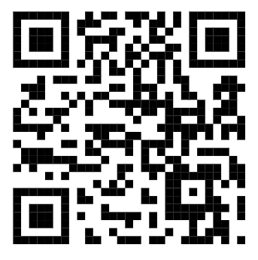
10
Would you like to go over Unity Basics again?
www.tolerance.gov.ae
https://shorturl.at/CoNNi

Slide 12
Thank you!

Slide 13
Madar
Tolerance Workshops
2025

